Slide 1











Implementing Routine Healthcare Worker Influenza Vaccination in Kenya: Coverage Outcomes from a Two-Phase Demonstration Project Across Four Counties, 2023–2025
Harriet Mirieri
Washington State University Global Health Kenya
Strengthening Public Health for Economic Development: Vaccine preventable diseases, AMR and IPC.
Ministry of Health
Kenya Health Security Convention | 5th – 8th May 2026 | Mombasa - Kenya

Slide 2
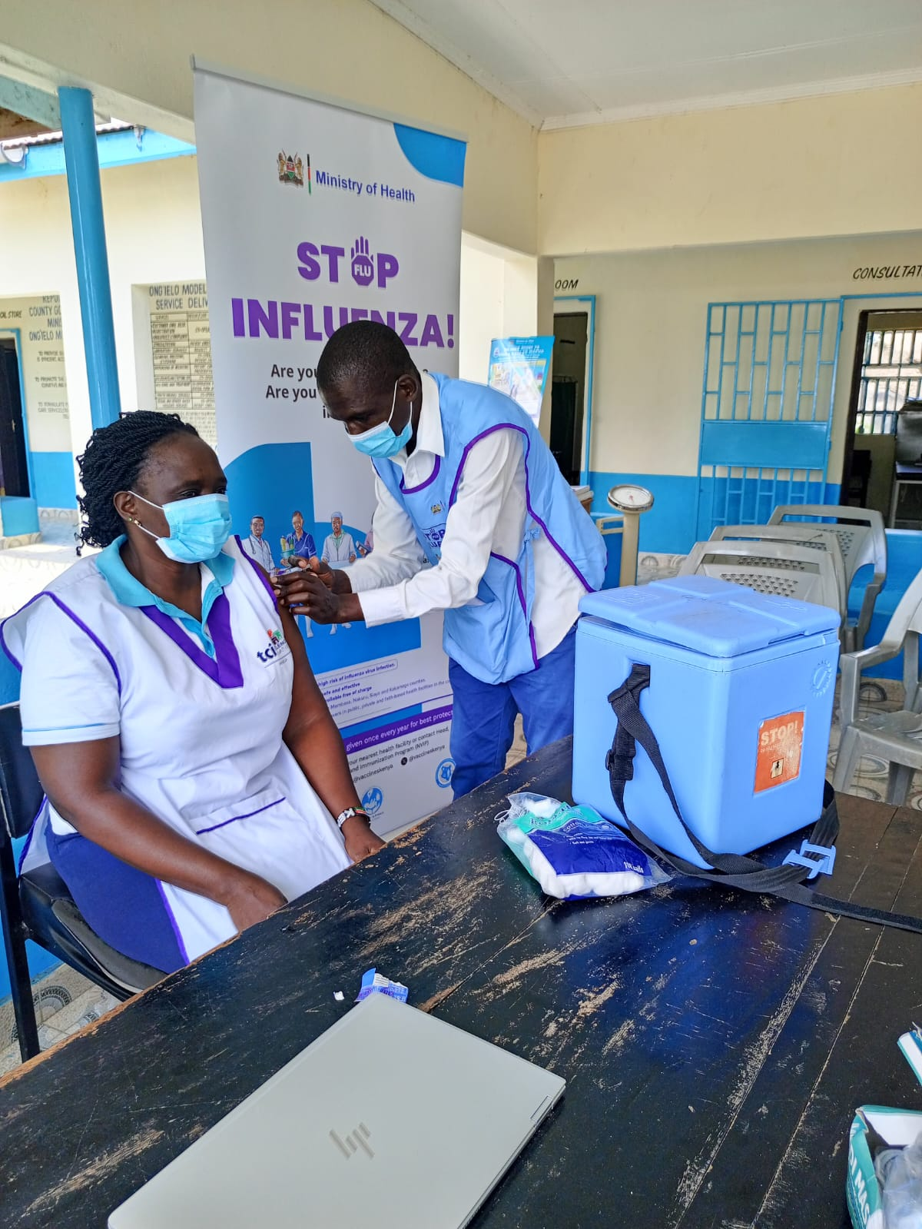
Background
Healthcare Worker (HCW) influenza vaccination project:
Implemented 2023-2025 across diverse operational settings
Collaboration between MoH (NVIP/DDSR), WSU and US CDC
Conducted within routine NVIP systems and structures
Targeted 4 counties: Nakuru, Kakamega, Siaya and Mombasa

Slide 3
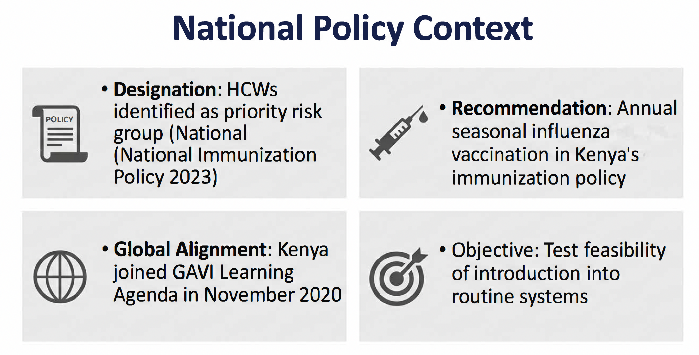

Background

Slide 4
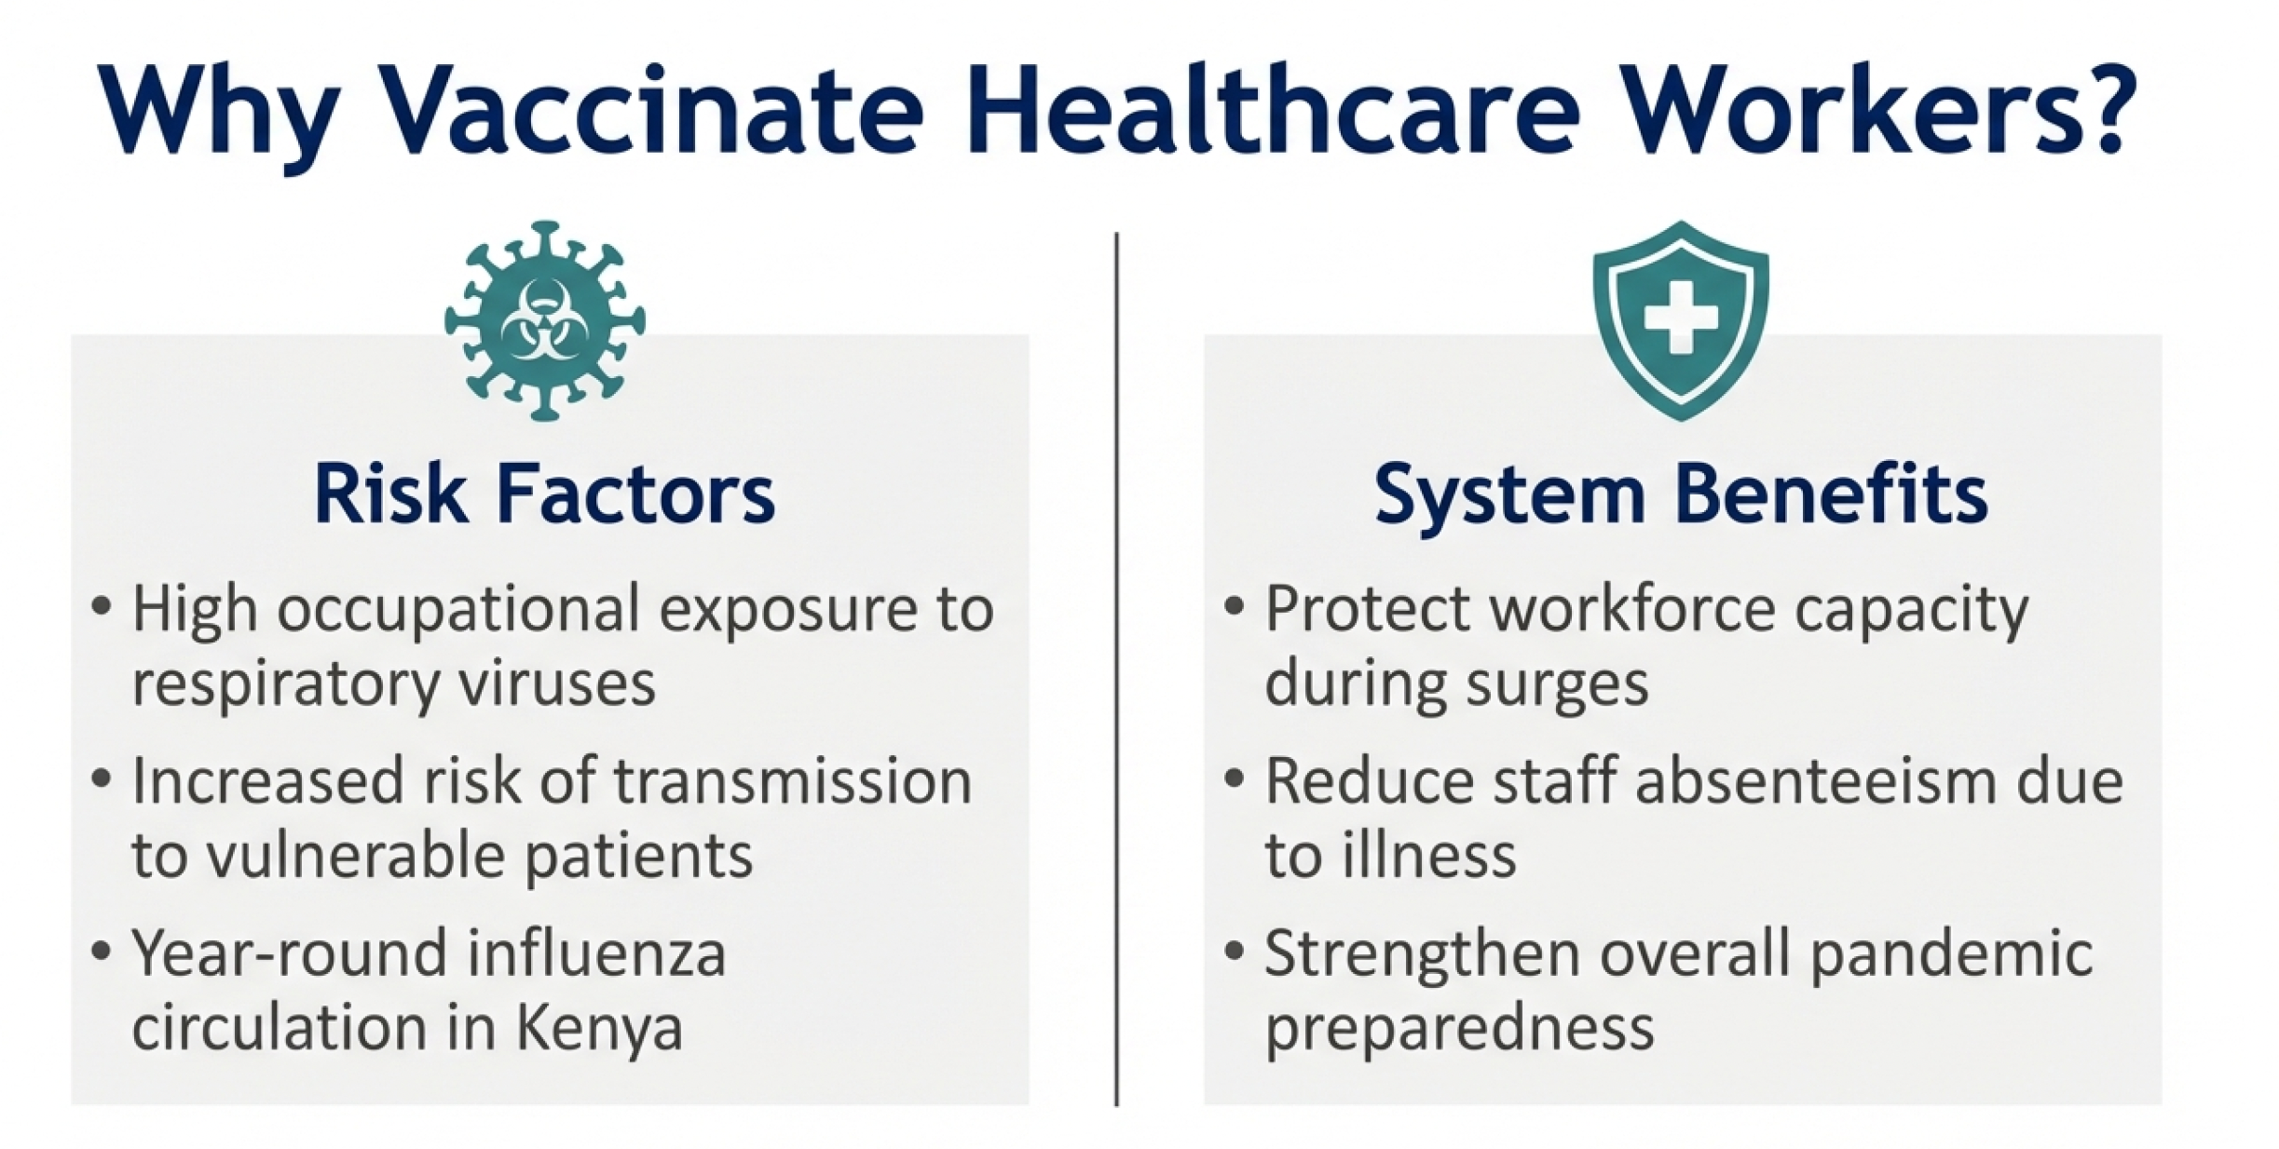
Background

Slide 5
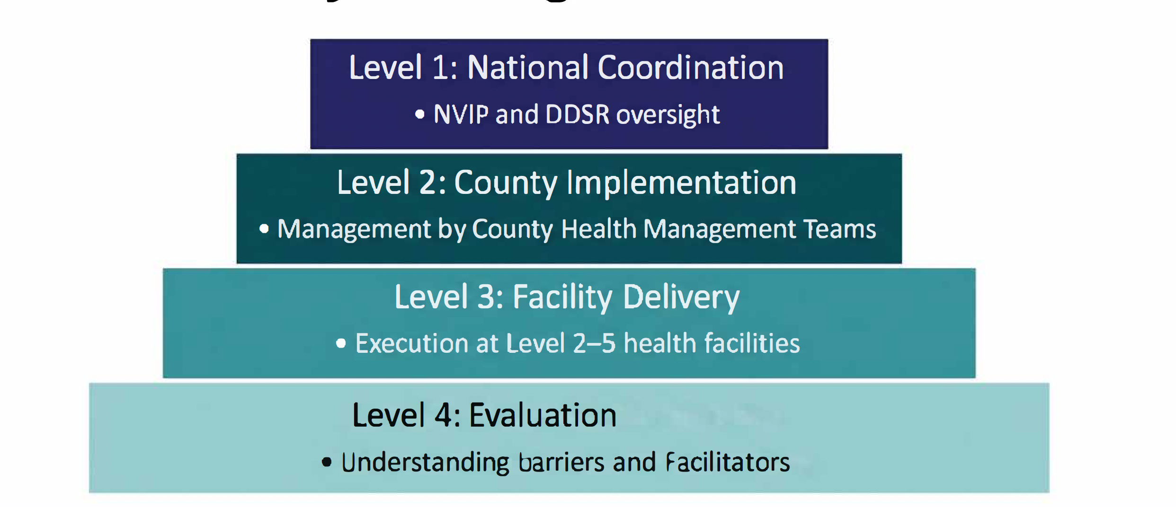
HCW Influenza Project Design

Slide 6
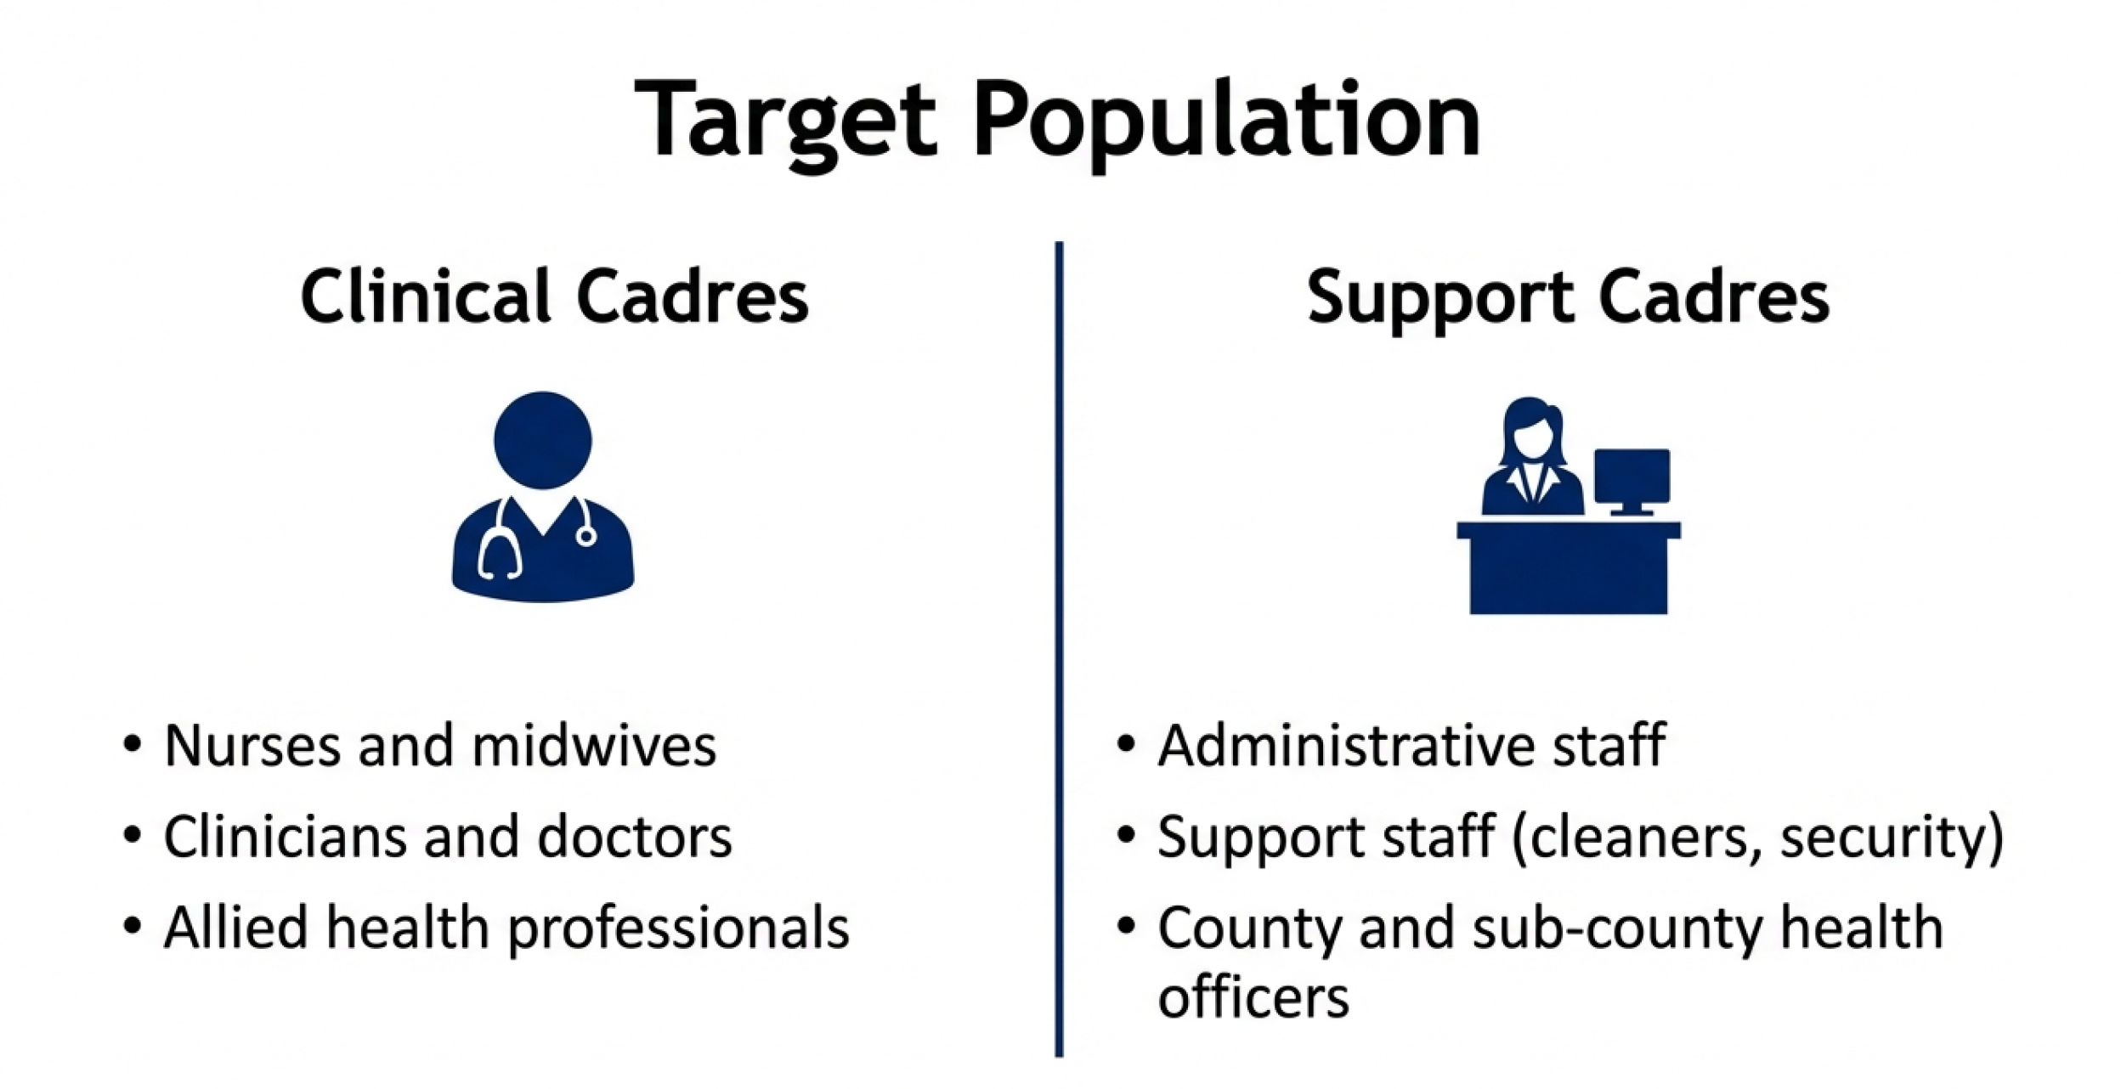
Methodology

Slide 7

Methodology
Fixed strategy
Established at level 5 facilities (High volume)
Static vaccination posts for staff convenience
Outreach strategy
Mobile teams visiting level 2-4 facilities
Department to department movement in large health facilities

Slide 8
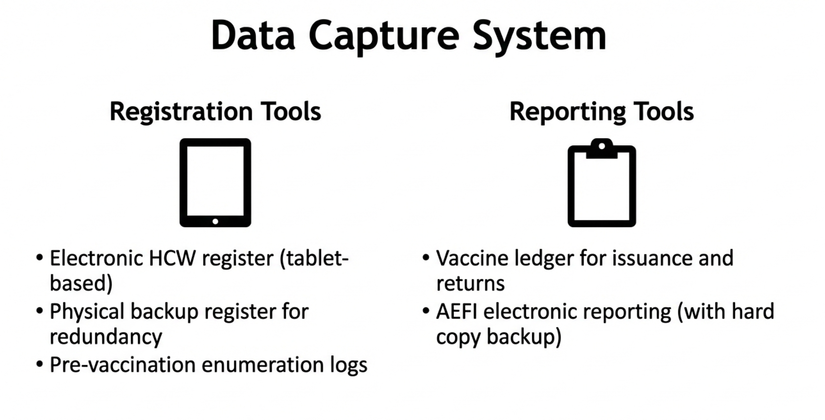
Methods
Target population: Before vaccination in each facility, vaccinators confirmed eligible staff totals with the facility in-charge via an electronic form.

Slide 9
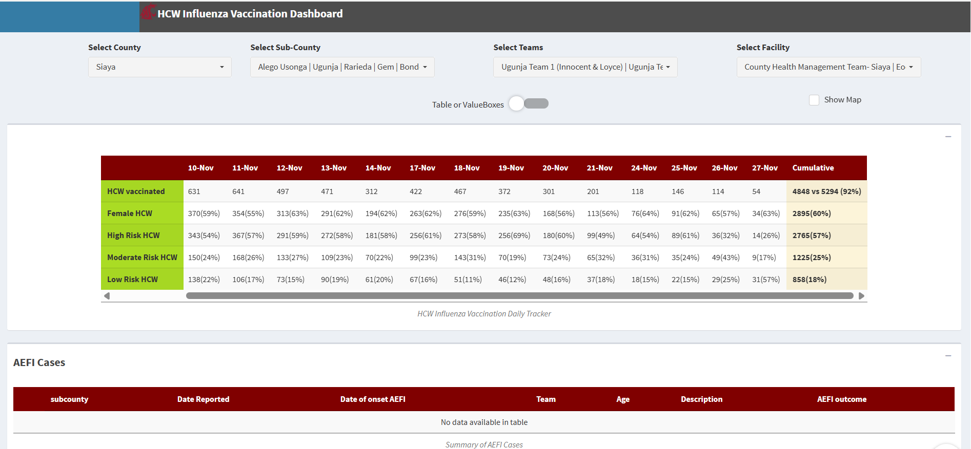
Vaccination monitoring
Support supervision visits using supervision tools
AEFI monitoring
Weekly meetings with vaccinators and county and sub county EPIs to review progress
Vaccination dashboards –Accessible to sub county teams

Slide 10
Influenza vaccination coverage
Phase 1 – Dec 2023 to Oct 2024 26,382 health workers vaccinated AEFIs – 16 reported. All resolved within 2 days | Phase 2 – Aug to Nov 2025 28,848 health workers vaccinated AEFIs – 11 reported. All were minor

Slide 11
Reasons for influenza vaccination

Slide 12
Reasons for not receiving influenza vaccination

Slide 13
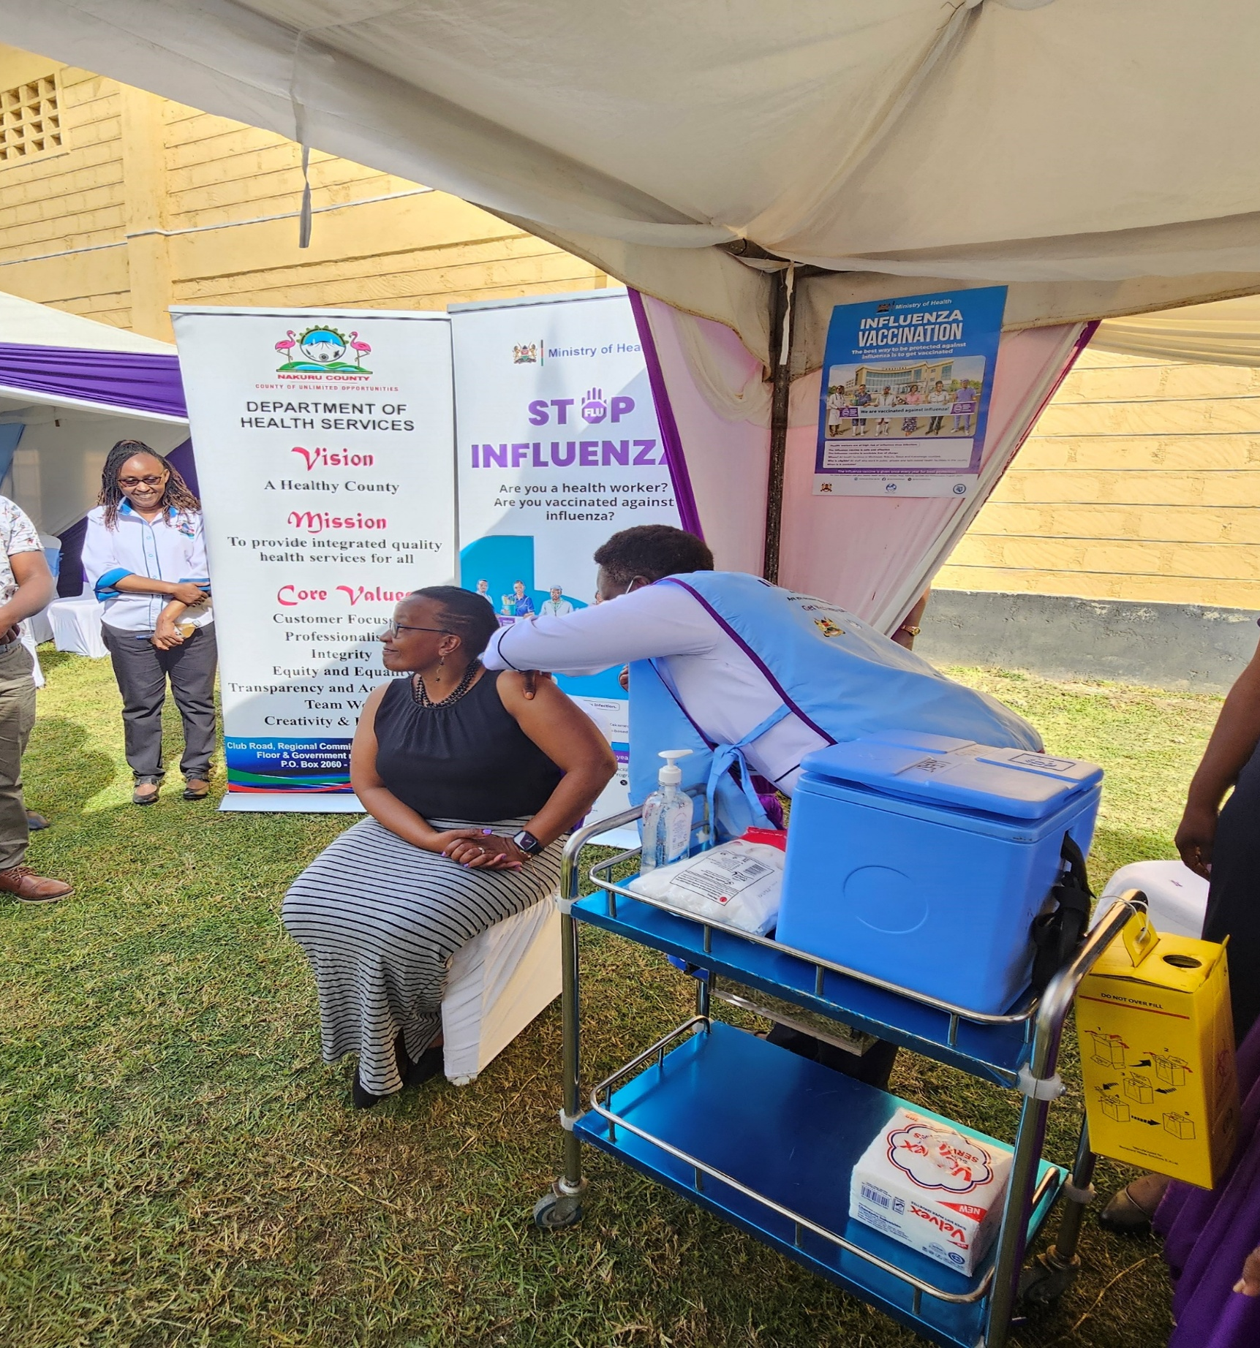
Lessons learnt from HCW vaccination project
Leadership endorsement critical
Digital systems enable real-time action: REDCap platform allowed daily coverage tracking and rapid problem-solving
On-site delivery removes barriers
Peer familiarity builds trust: HCWs vaccinating colleagues reduced hesitancy more effectively than external teams
Documentation valued: Vaccination certification motivated uptake for professional portfolios

Slide 14

Conclusion
Kenya's immunization system can deliver influenza vaccines at scale:
  ~26,000 healthcare workers vaccinated with 79-98% coverage
This capacity serves dual purposes:
  IMMEDIATE: Reduce annual seasonal influenza burden in high-risk groups
  STRATEGIC: Maintain standing infrastructure for rapid pandemic response
What we demonstrated
  High coverage is achievable with existing infrastructure
  Implementation barriers are known and addressable
  Kenya is operationally ready for scaled influenza vaccination
Operational readiness proven - policy action needed

Slide 15

Thank you!
Scan to visit our website
#KeHSCon2026
@NPHIKenya
www.nphi.go.ke

